Slide 1


SIMATS ENGINEERING
SAVEETHA INSTITUTE OF MEDICAL AND TECHNICAL SCIENCES
Capstone project presentation
AI-Driven Road Damage Detection and Severity Assessment Using YOLO-Based Deep Object Detection
CSA1707 - ARTIFICIAL INTELLIGENCE
Presented by:
K Tejaswi(192371036)
B Harshini(192371088)
A Sai Swetha(192319072
Guided By:-
Dr. R.Veeramani

Slide 2
INTRODUCTION
Road damage such as potholes, cracks, and surface deterioration is a major problem that affects vehicle safety, transportation efficiency, and road maintenance.
Traditional road inspection methods depend heavily on manual surveys, which are time-consuming, expensive, and sometimes subjective.
The proposed project uses Artificial Intelligence and YOLO-based deep object detection to automatically identify road damages from images or video.
The system detects different types of road damage and estimates their severity as low, medium, or high.
This helps authorities prioritize road repairs and enables faster, more accurate, and data-driven road maintenance.

Slide 3
ABSTRACT
Road damage, such as potholes and cracks, affects vehicle safety, road quality, and transportation efficiency.
Traditional manual road inspection is time-consuming, costly, and may produce inconsistent results.
The proposed system uses Artificial Intelligence and YOLO-based deep object detection to automatically identify road damage from images and videos.
The system classifies different types of damage and provides bounding boxes with confidence scores.
The system provides a fast, accurate, and scalable solution for road monitoring and can be extended with GPS, GIS, IoT, and real-time vehicle-based detection.

Slide 4
PROBLEM STATEMENT
Problem
Road potholes and cracks cause accidents and vehicle damage.
Manual road inspection is slow and costly.
Large road networks are difficult to inspect regularly.
Human assessment may be inaccurate or subjective.
Existing systems have limited real-time detection.
An AI-based YOLO system is needed for fast damage detection and severity assessment.

Slide 5
OBJECTIVES
Automatic Road Damage Detection: Detect potholes, cracks, and other road damages automatically using a YOLO-based deep learning model.
Damage Classification: Identify and classify different types of road damage from images and video frames.
Reduce Manual Inspection: Minimize the time, cost, and human effort required for traditional road-condition surveys.
Improve Accuracy: Provide consistent and reliable road-damage detection using AI-based image analysis.
Support Road Maintenance: Help authorities prioritize damaged locations and make faster decisions for road repair and maintenance.

Slide 6
Existing System
Manual Road Inspection: Road conditions are inspected manually by engineers or maintenance workers.
Periodic Surveys: Roads are checked at fixed intervals, which may not identify newly developed damage quickly.
Manual Damage Classification: Potholes and cracks are identified and categorized based on human observation.
Time and Cost Intensive: Large road networks require significant manpower, time, and resources for inspection.
Limited Real-Time Monitoring: Existing methods generally cannot continuously monitor roads or provide instant damage detection.

Slide 7
Existing System Drawback
Drawbacks:
Time-consuming manual inspection.
Requires significant manpower.
Assessment can be subjective.
Difficult to monitor large road networks.
Delayed identification of serious damage.
Limited real-time detection capability.

Slide 8
Proposed System
In the existing system, road condition monitoring is mainly performed through:
Manual inspection by road maintenance personnel.
Periodic physical surveys.
Citizen complaints and photographs.
Basic image-processing techniques.
Separate systems for detecting different types of road damage.
Manual estimation of damage severity.
The collected information is generally analyzed manually before maintenance decisions are made.

Slide 9
Proposed System features
Automatic road-damage detection.
Pothole and crack classification.
Bounding-box visualization.
Confidence-score display.
Severity classification.
Image and video processing.
Detection-result storage.
Maintenance-priority generation.

Slide 10
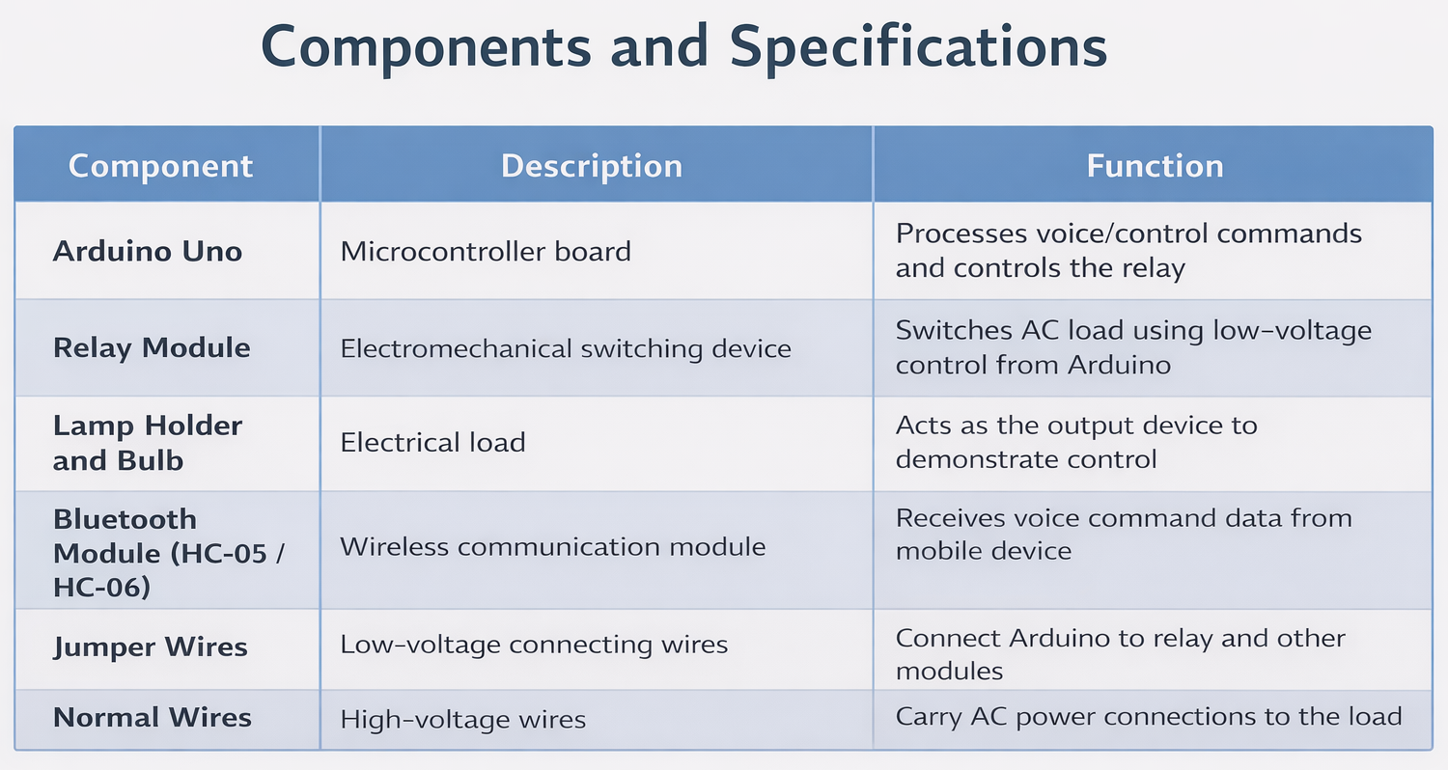
LITERATURE REVIEW
Year | Paper / Study | Method Used | Advantage | Disadvantage | Outcome | Helpful for Our Study
2022 | Automated Road Crack Detection Using Deep Neural Networks | CNN-based image classification and object detection | Provides automated and consistent crack identification | Mainly focuses on cracks and may not detect all types of road damage | Deep neural networks achieved effective crack detection from road images | Yes – Useful for identifying and categorizing road cracks.
2023 | Deep Learning-Based Road Damage Detection Using YOLO | YOLO object detection with deep convolutional neural networks | Real-time detection with good accuracy and faster processing | Requires a sufficiently large and diverse annotated dataset | Successfully detects different categories of road damage from images | Yes – Helps in selecting YOLO for efficient real-time road damage detection
2022 | Road Damage Detection Using Deep Learning and Computer Vision | CNN, YOLO and image-processing techniques | Automates road inspection and reduces manual monitoring effort | Detection accuracy is affected by complex backgrounds and environmental conditions | Deep-learning models effectively identify cracks and potholes | Yes – Supports the use of computer vision for automated road inspection.

Slide 11
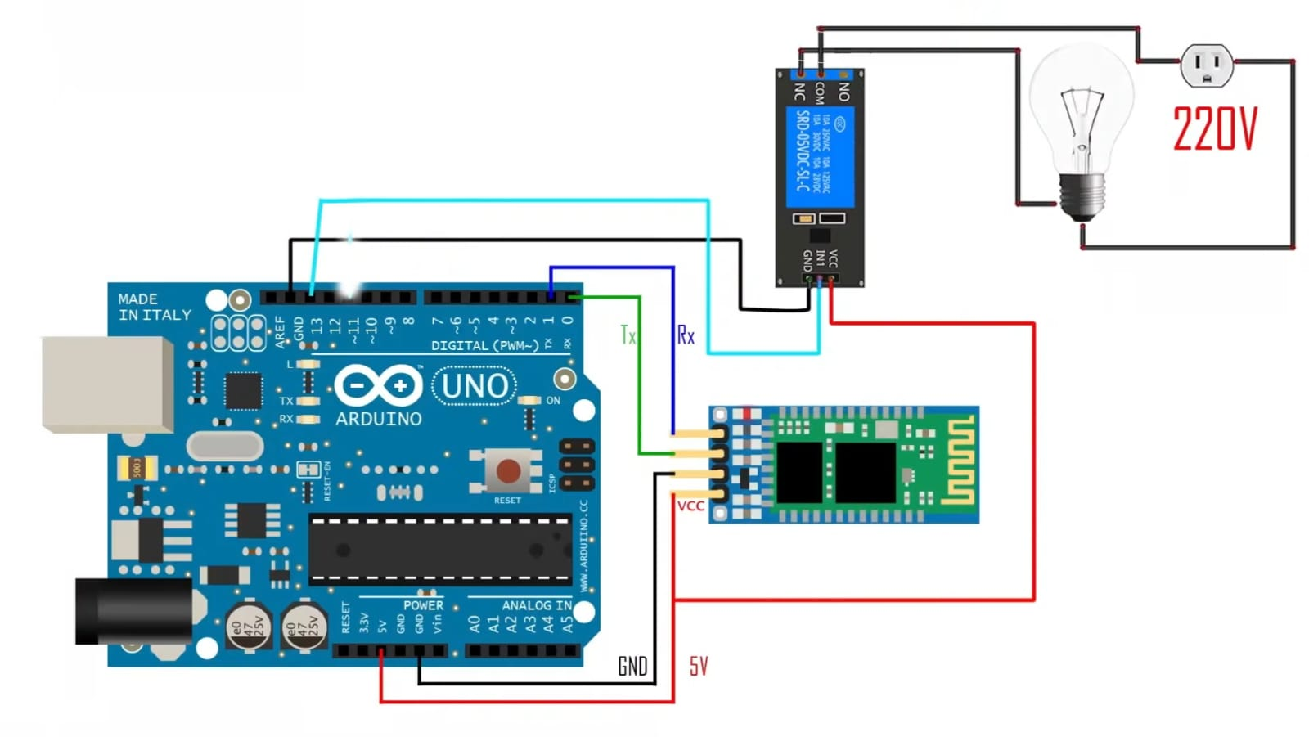
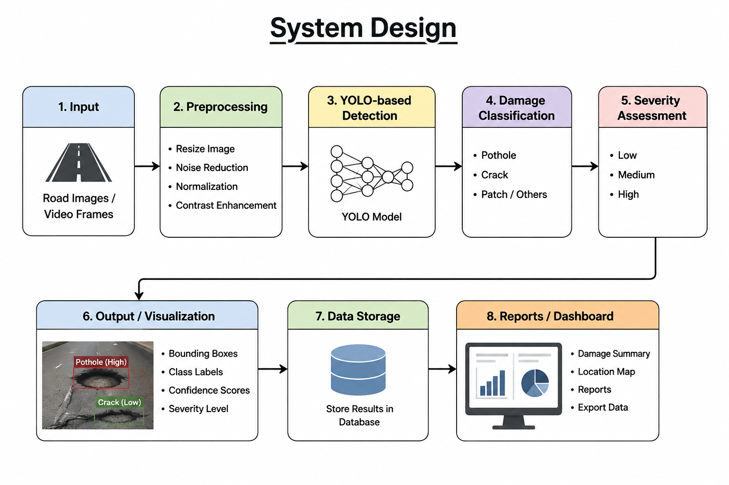
SYSTEM DESIGN

Slide 12
DATA SET
A suitable dataset can contain road images collected from public road-damage datasets, vehicle-mounted cameras, smartphones, or manually captured images.
Dataset Preparation
Collect road images.
Remove poor-quality or duplicate images.
Annotate damaged regions using bounding boxes.
Assign appropriate damage classes.
Divide the dataset into:
Training set
Validation set
Testing set
Apply augmentation such as rotation, scaling, flipping and brightness variation.
Convert annotations into the format required by the selected YOLO implementation.

Slide 13
Technologies
Front End:
HTML – Creates the web page structure.
CSS – Provides styling and layout.
JavaScript – Handles user interaction and image/video upload.
Bootstrap – Used for responsive and user-friendly design.
Streamlit – Can be used to create a simple AI detection interface.
BackEnd:
Python – Main programming language.
Flask – Connects the frontend with the AI model.
YOLO – Detects potholes, cracks, and other road damages.
OpenCV – Processes images and video frames.
PyTorch – Supports YOLO model training and inference.
Database – Stores detection results, severity, and related information
Tools:
Google Colab / Jupyter Notebook-model training
MySQL / MongoDB – database
VS Code-development

Slide 14
Module 1:Image Acquisition & Preprocessing
This module collects road images or video frames from cameras or uploaded files.
Functions
Image upload.
Frame extraction from video.
Image resizing.
Noise reduction.
Normalization.
Data augmentation.
Input: Road image/video Output: Preprocessed image/frame

Slide 15
Module 2:YOLO-Based Road Damage Detection
This is the main AI module.
The trained YOLO model processes the image and identifies road-damage objects. It generates:
Bounding boxes
Damage class
Confidence score
Object location
Example:
Input Image
↓
YOLO Model
↓
Pothole – 92% confidence
Crack – 87% confidence

Slide 16
Module 3:Severity Assessment and Reporting
This module determines the seriousness of detected road damage.
Severity Levels
Low
Small damaged region
Minor cracks
Low maintenance priority
Medium
Moderate damage
Larger cracks or potholes
Requires planned repair
High
Large potholes or extensive cracks
Significant road-safety risk
Requires urgent maintenance
The detected results can be stored in a database and presented through a dashboard or generated report.

Slide 17
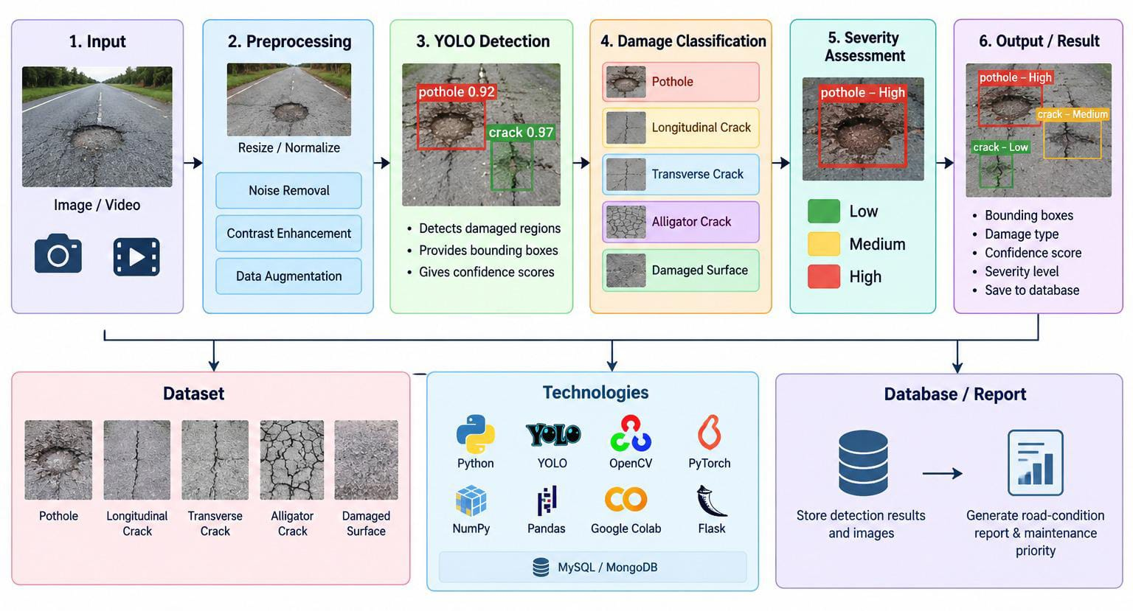
Methodology

Slide 18
RESULTS & DISCUSSION
Results
YOLO successfully detects road potholes and cracks.
Different damage types are classified automatically.
Damage severity is identified as Low, Medium, or High.
Discussion
The results demonstrate that a YOLO-based approach can provide an efficient and automated alternative to manual road inspection.
The system can process different road conditions and identify multiple damages in a single image.
Performance may vary depending on image quality, lighting, weather conditions, camera angle, and the size of the damaged region.
Training with a larger and more diverse dataset can further improve detection accuracy and reliability.

Slide 19
CONCLUSION & FUTURE SCOPE
The AI-Driven Road Damage Detection and Severity Assessment System using YOLO provides an efficient approach for automatic road-condition monitoring.
By combining deep-learning-based object detection with severity assessment, the system can identify road damage quickly and assist authorities in prioritizing maintenance.
Future scope
Integration with GPS/GIS to map damaged road locations.
Real-time detection using vehicle-mounted cameras.
Mobile application for road-condition reporting.
Integration with IoT sensors for additional road-condition data.
Predictive maintenance using historical road-damage data.

Slide 20
REFERENCES
□
References
J. Redmon et al., “You Only Look Once: Unified, Real-Time Object Detection,” IEEE Conference on Computer Vision and Pattern Recognition (CVPR), 2025
J. Redmon and A. Farhadi, “YOLO9000: Better, Faster, Stronger,” IEEE Conference on Computer Vision and Pattern Recognition (CVPR), 2024.
J. Redmon and A. Farhadi, “YOLOv3: An Incremental Improvement,” arXiv preprint, 2018.
G. Jocher et al., “Ultralytics YOLO,” Ultralytics, 2026.
R. G. Maeda et al., “Road Damage Detection and Classification Using Deep Neural Networks with Smartphone Images,” Computer-Aided Civil and Infrastructure Engineering, 2015.
S. Arya et al., “RDD2022: A Multi-National Image Dataset for Automatic Road Damage Detection,” arXiv preprint, 2026.

Slide 21


